Slide 1
Risk Management Plan
An Example of a Dynamically Generated PowerPoint Slide Deck
UPDATED: 12.07.2020

Slide 2
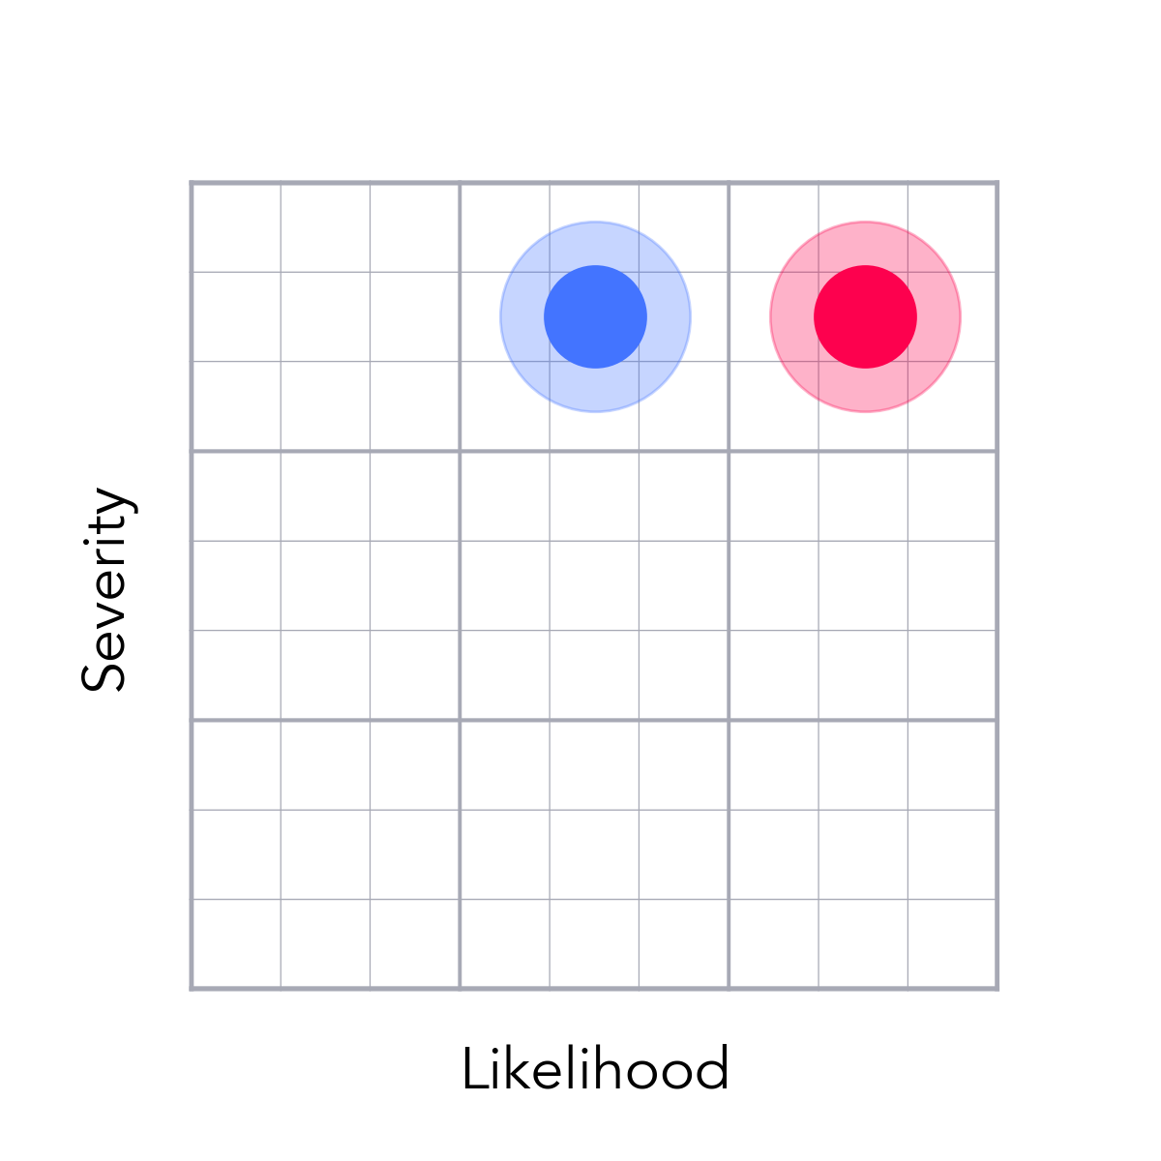
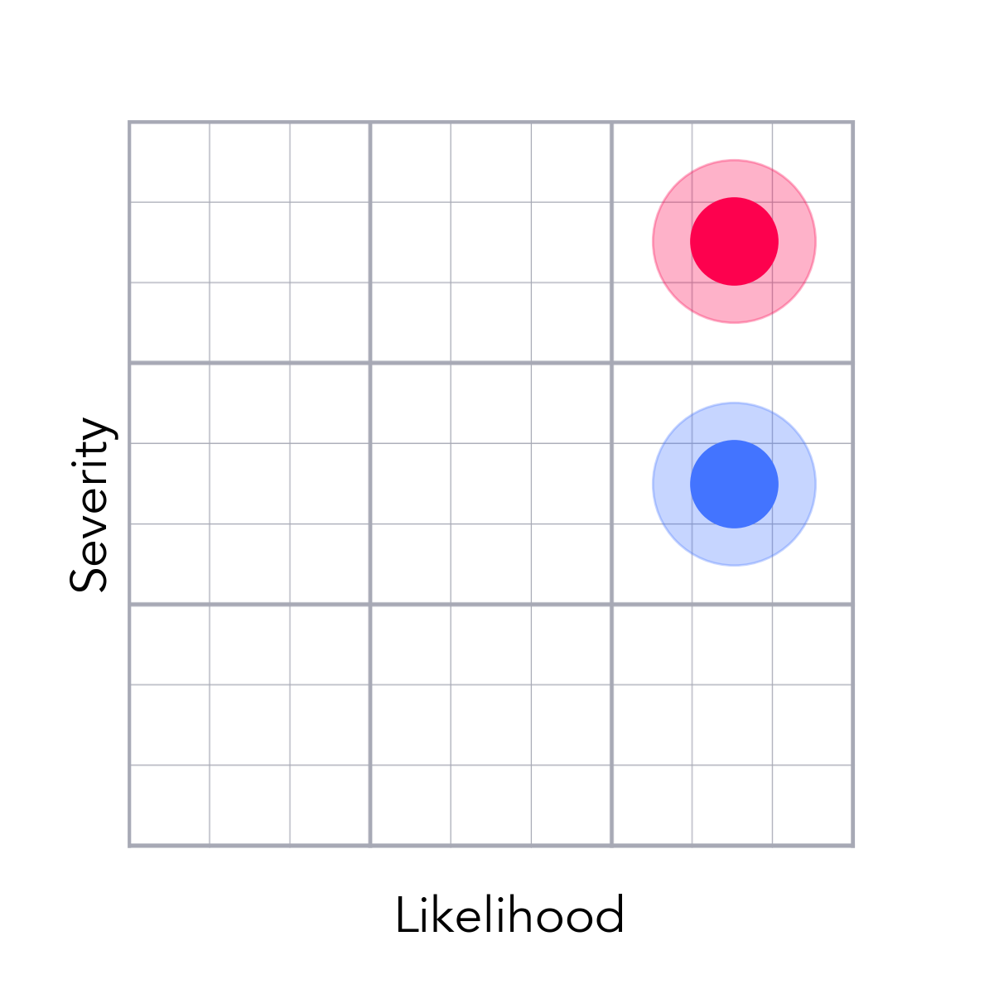
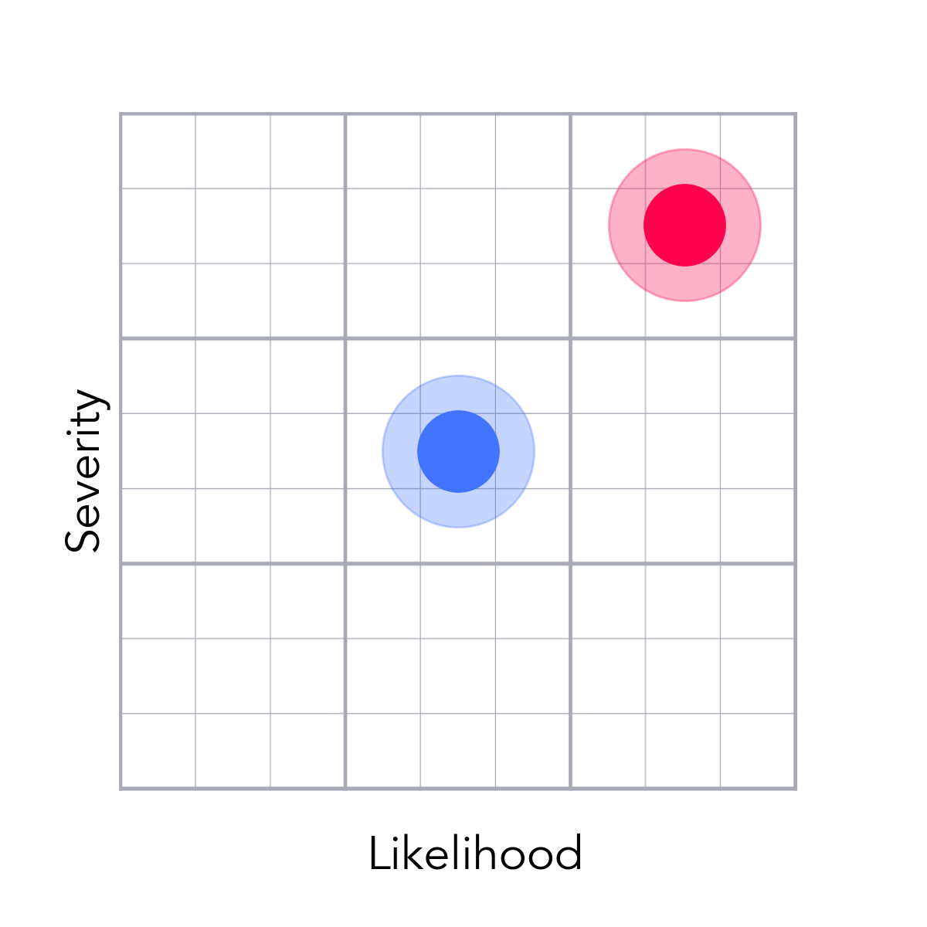
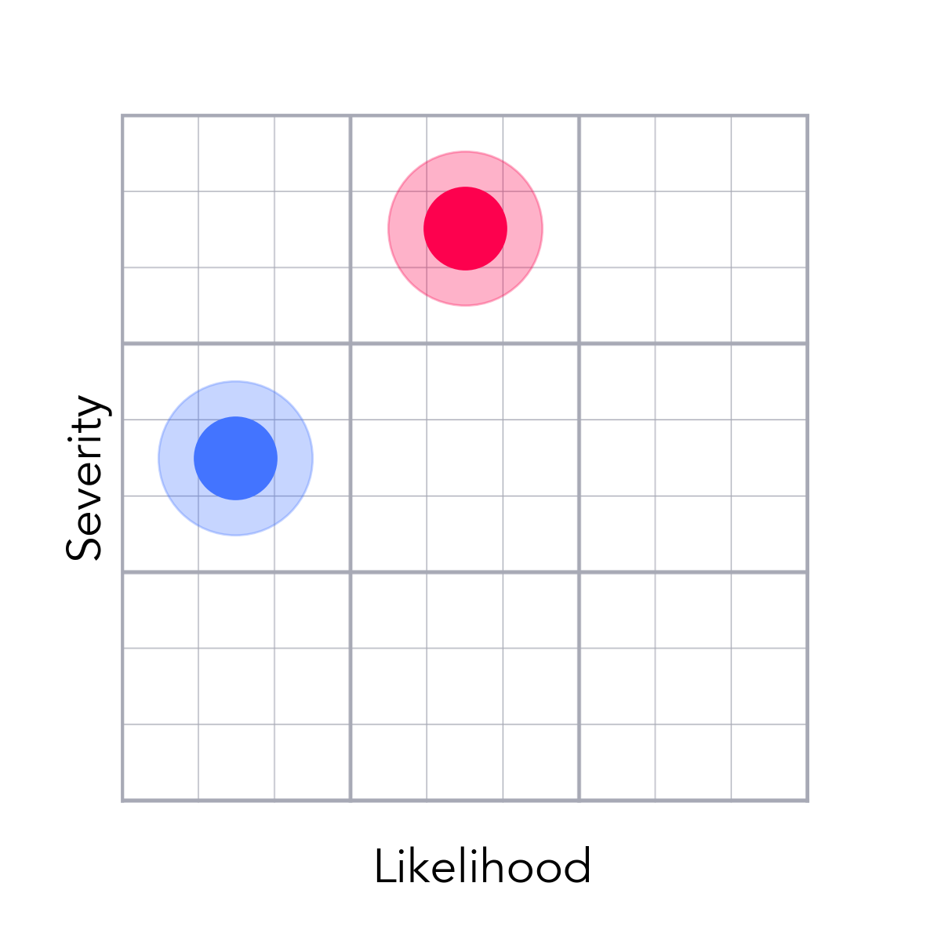
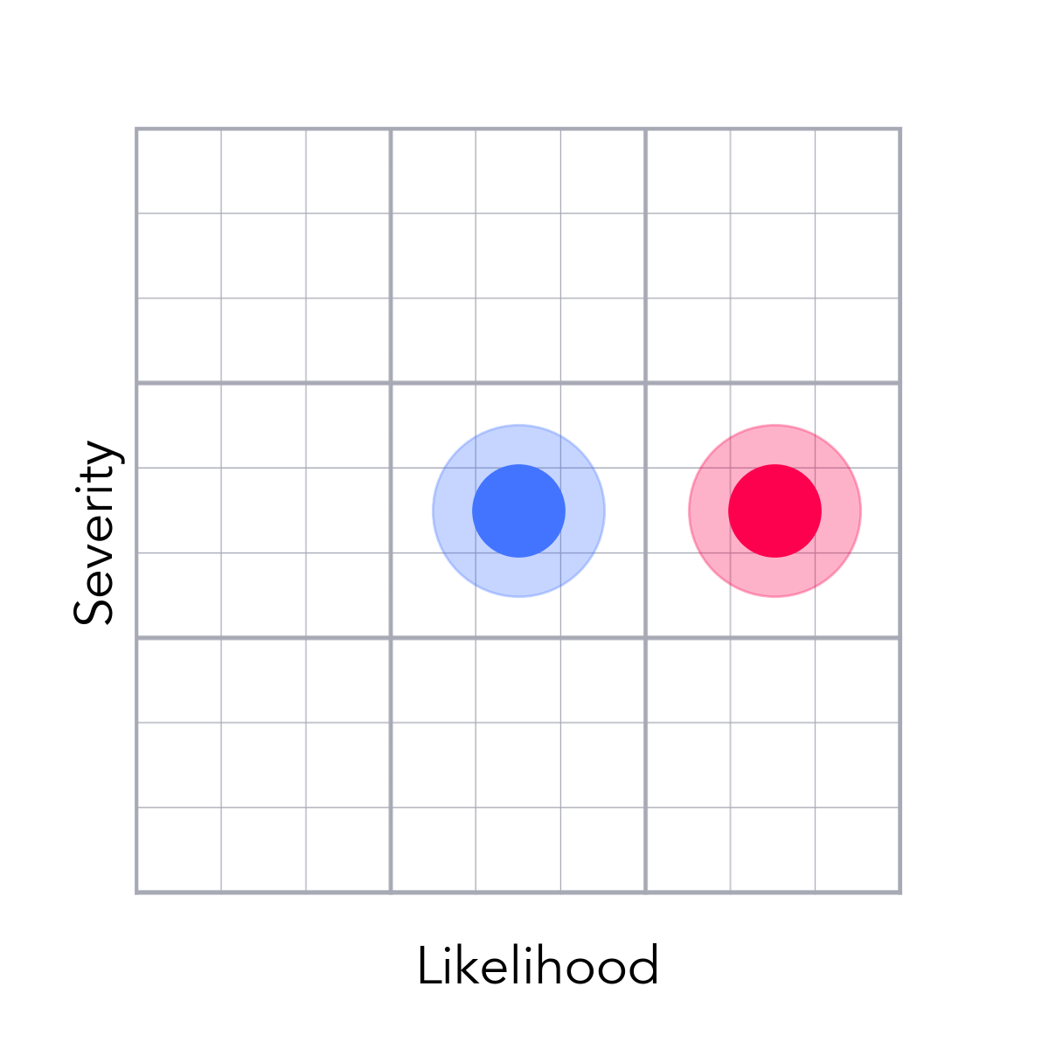
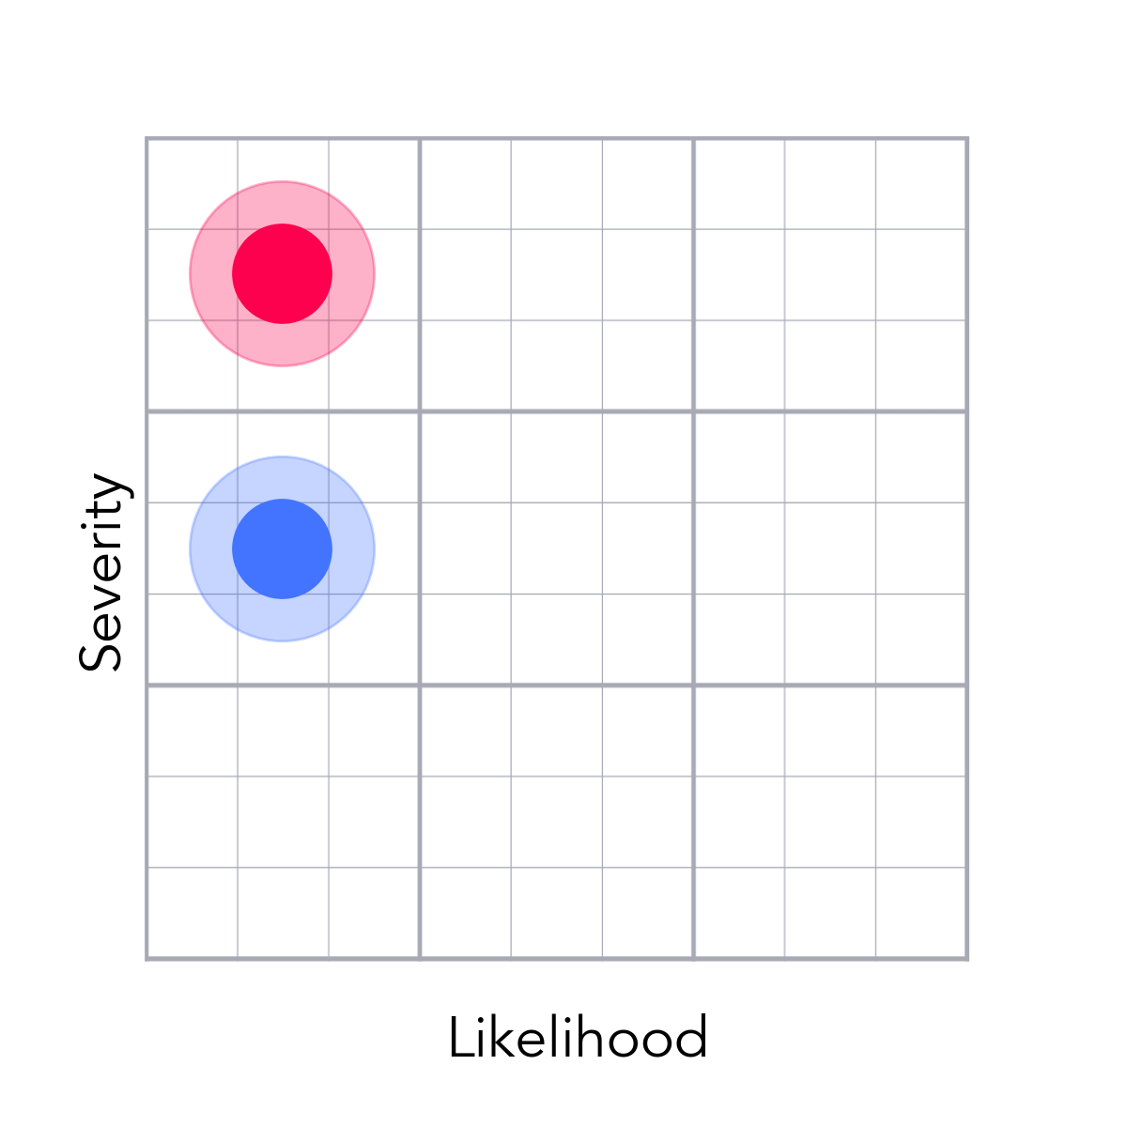
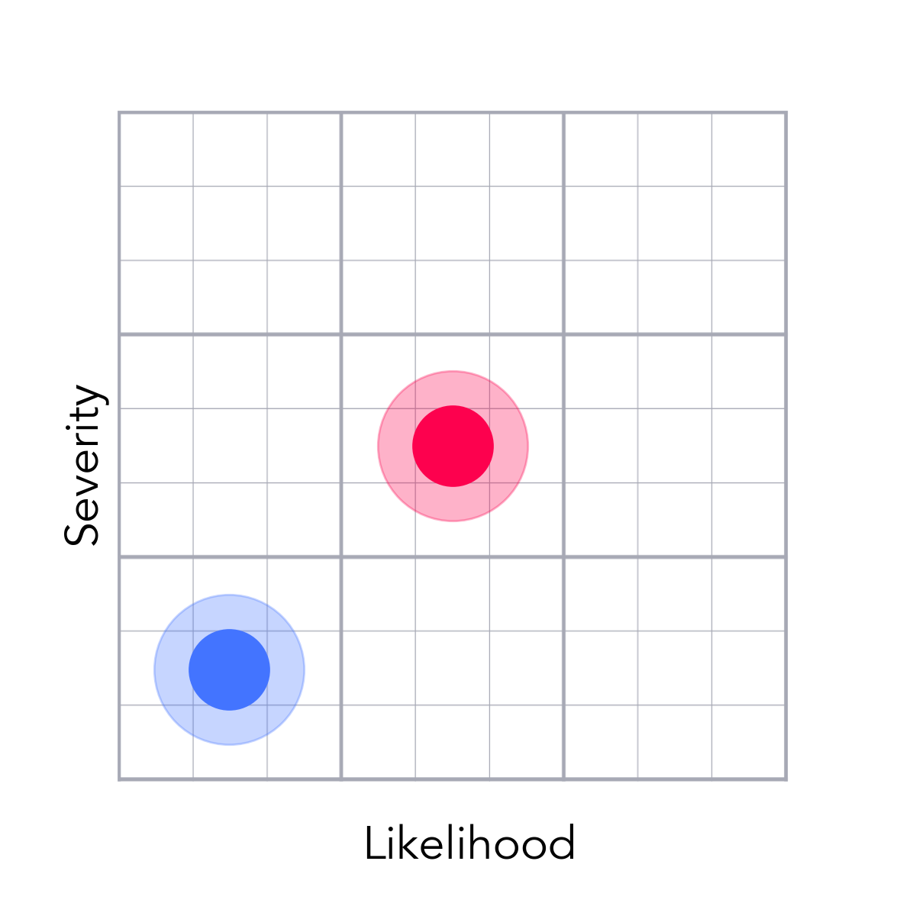
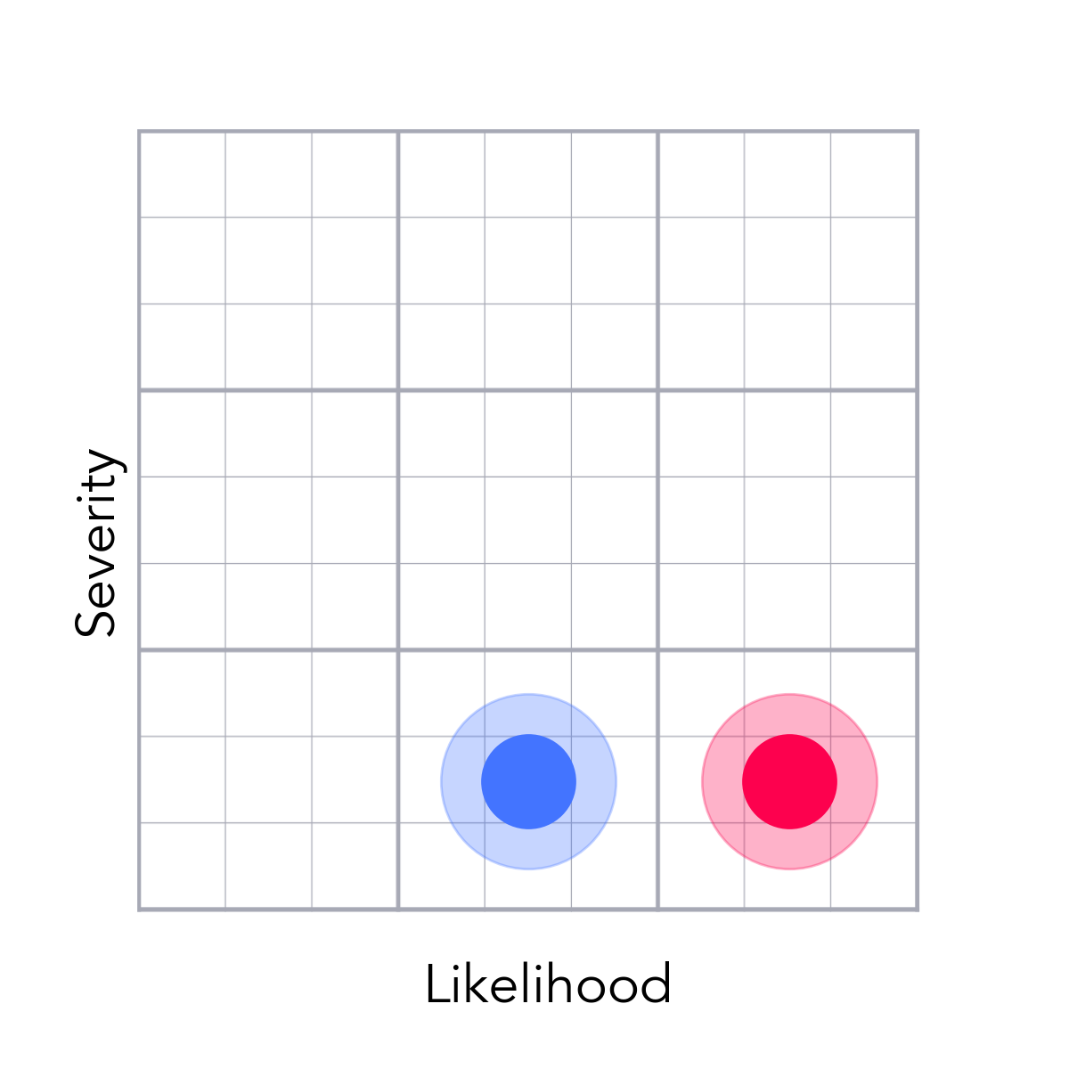
Risk Readiness
Test 1
Bureau Agreements
Something New
System Disunity
FI Feedback Delays
Outsource Quality
p.3
p.4
p.5
p.6
p.7
p.8
Resource Crashing
Something Very New
Frenemy Partners
Reporting Blindspots
Complex Value Props
Build IT Efficacy
p.9
p.10
p.11
p.12
p.13
p.14
Subscription Cost
Disparate Environments
Truncated QA
Election 2020
Reward IT Payout Delays
Customer Life
p.15
p.16
p.17
p.18
p.19
p.20

Slide 3
Issuers Might Take Exception to Reward It Payouts
Test 1
Prime issuers view Reward IT traffic as high-risk, or low quality because of their interpretation of "incentivized traffic"
We loose the partnership with the FI and are not able function as an affiliate
The value to the consumer goes down as we aren't able to offer our highest rewards; Business viability goes down as we forego FI revenue.
Visit major brands to pitch Extra Credit and get approval for financial products to be featured in Reward It
Launch with a smaller catalog and onboard more issuers as we grow volumes
GM
Mitigated
Value

Slide 4
Slow Bureau Processes Put Pressure on Timelines
Bureau Agreements
Red tape around bureau agreements have unpredictable timelines
Development and QA will have delayed access to Bureau specific short-codes and environments
The schedule would be delayed and we miss Q1 delivery
Work with bureaus to create gap contracts that will allow us early access to components. Streamline negotiations, contract review, and legal approval processes.
Develop the architecture and user experience without dependencies on all three bureaus so that we can remove certain bureaus from production environments and launch with less than three bureaus
Dev
Mitigated
Feasibility

Slide 5
We Need to Vet Breaking Points in Our Systems
Something New
Various disparate systems that need to communicate and transfer information to each other — what is being sent won't be what is expected and get an error
Customer records where customer accounts aren't recognized (can't log in) or customers don't get reward it money or
Customers can't access or use products as designed
Thoroughly vet systems with end-to-end testing, end user testing with private betas (Friends & Family 50 and Ambassador 250 prior to a general launch.
Set the standards to pass out of beta testing and don't allow a product in the market that cannot pass our minimum standards.
Dev Ops
Mitigated
Usability

Slide 6
We Need to Vet Breaking Points in Our Systems
System Disunity
Various disparate systems that need to communicate and transfer information to each other — what is being sent won't be what is expected and get an error
Customer records where customer accounts aren't recognized (can't log in) or customers don't get reward it money or
Customers can't access or use products as designed
Thoroughly vet systems with end-to-end testing, end user testing with private betas (Friends & Family 50 and Ambassador 250 prior to a general launch.
Set the standards to pass out of beta testing and don't allow a product in the market that cannot pass our minimum standards.
Dev Ops
Mitigated
Usability

Slide 7
FIs Tend to Give Delayed Feedback on Payouts
FI Feedback Delays
We don't always hear from FIs in a timely manner that a subscriber was approved for credit.
Subscribers don't get their money
Frustrated subscribers spike customer service tickets and churn at high rates
Set clear expectations that customers will get payment "after 1-2 billing cycles" by spotlighting the information clearly before they apply
Manage customer satisfaction through zen desk support tickets to clarify and track down payments
GM
Mitigated
Value

Slide 8
Nearshore Development Carries Challenges
Outsource Quality
Important modules are dependent on outsourced teams where communication is challenging
Communication is challenged or broken between internal and external teams
Quality of work
Manage resources tightly and with regular check-ins and demos
Bring failing components inhouse to manage more tightly
Dev
Mitigated
Usability

Slide 9
Resources Spread Thin Across Multiple Initiatives
Resource Crashing
CCPA, PCI, SFDC 2020 priorities
Resources will have to jump onto other projects to address fires and issues
Resource scarcity pushing back timelines
Block out key resources through beta testing and until launch
Have strategic discussions with executive team members to prioritized against the company vision and most important needs of the organization.
Product
Mitigated
Feasibility

Slide 10
Service Partners Have Competing B2C Products
Something Very New
We have major partners (Experian, & Level Credit) who also have B2C products in the space
Partners may seek to drop us after launch
The product will have gaps in feature sets, we won't be able to fulfill our promises to consumers, and we'll lose customers while having difficulty attracting new ones
Establish strong, mutually beneficial business agreements with the key strategic partners and make it difficult for them to sever ties.
Develop abilities to fill the gaps and build credit with other strategies. Limit dependencies on Experian and form a narrative around 2 bureau reports.
Partnerships
Mitigated
Feasibility

Slide 11
Service Partners Have Competing B2C Products
Frenemy Partners
We have major partners (Experian, & Level Credit) who also have B2C products in the space
Partners may seek to drop us after launch
The product will have gaps in feature sets, we won't be able to fulfill our promises to consumers, and we'll lose customers while having difficulty attracting new ones
Establish strong, mutually beneficial business agreements with the key strategic partners and make it difficult for them to sever ties.
Develop abilities to fill the gaps and build credit with other strategies. Limit dependencies on Experian and form a narrative around 2 bureau reports.
Partnerships
Mitigated
Feasibility

Slide 12
We Need to Close Gaps in Media Reporting
Reporting Blindspots
Nightmarish paid media reporting
nan
nan
Build comprehensive reporting deck with all the criteria needed to effectively manage the marketing spend
Set the standards to pass out of beta testing and don't allow a product in the market that cannot pass our minimum standards.
Marketing
Mitigated
Viability

Slide 13
We Need a Simple Hook for Marketing
Complex Value Props
Complexity and vastness of product features
Difficult to create concise marketing messaging that will resonate with consumers and communicate value effectively
Confused users won't subscribe putting pressure on volume
Develop a compelling and informative "Launch Pad" experience and pithy product marketing descriptions to make the product components compelling and easy to understand
Develop tailored Re-engagment campaigns folded into a customer experience communications plan
Marketing
Mitigated
Viability

Slide 14
Build It Needs To Fullfil Member Expectations
Build IT Efficacy
Anecdotal use of Credit Pop (Level Credit, a.k.a., RentTrack) didn't make a difference in a team member's score
Consumers don't see score improvement results from Build IT
Consumers don't see value from Build It feature set
Set expectations with messaging; set messaging to the right target audience
Develop abilities to fill the gaps and build credit with other strategies.
Product
Mitigated
Value

Slide 15
Consumers May Be Sensitive to Fees Above $10
Subscription Cost
We have a belief that subscription fees above $10 are more highly scrutinized by consumers
Difficulty to acquire clients
Pressure to LTV
Minimize subscription costs and clearly outline the value to the consumer
Price test in 2021 to find the optimal price points for volume and profitability
Marketing
Mitigated
Value

Slide 16
We Need to Vet Breaking Points in Our Systems
Disparate Environments
Environments not matching
nan
nan
Thoroughly vet systems with end-to-end testing, end user testing with private betas (Friends & Family 50 and Ambassador 250 prior to a general launch.
Set the standards to pass out of beta testing and don't allow a product in the market that cannot pass our minimum standards.
Dev Ops
Mitigated
Usability

Slide 17
Compressed Timelines Leaves Less Time for QA
Truncated QA
Truncated QA schedule
We aren't able to catch all development issues.
Production errors.
Put more on UAT to cover all look and feel QA responsibilities
Launch to limited audiences prior to a general launch
QA
Mitigated
Usability

Slide 18
Media is Expensive in an Election Year
Election 2020
Election in 2020
Media costs up; attention down
Pressure on LTV and volume
Push to get the product into the public market by early summer, ramp up spend early, and ramp down as we get into competitive spending season. Thoroughly optimize the database marketing funnel and build a DB marketing war chest with a "wishlist" campaign during private betas
Reduce spend that does not meet our CPA targets
Marketing
Mitigated
Viability

Slide 19
Payouts On Reward It Need To Be Swift
Reward IT Payout Delays
Getting approval feedback from FI partners can sometimes take weeks to get
Subscribers have to wait with little transparency into the timelines or status of their rewards
Frustrated subscribers spike customer service tickets and churn at high rates
Set clear expectations that customers will get payment "after 1-2 billing cycles" by spotlighting the information clearly before they apply
Manage customer satisfaction through zen desk support tickets to clarify and track down payments
Product
Mitigated
Usability

Slide 20
Customers Need To Stay Members for 20 Months
Customer Life
Direct care customers typically stay 8 months less than our target
Modeled assumptions of the financial plan get missed
Pressure on LTV
Have reporting that tightly monitors and understands customer life with early predictive models
Develop tailored Re-engagment campaigns folded into a customer experience communications plan
Marketing
Mitigated
Viability

Slide 21
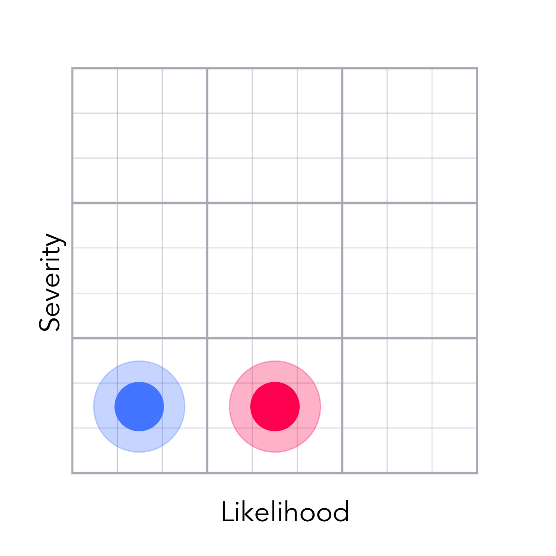
User Experiences Need to Be Steller on All Devices
Mobile Usability
Rollouts of the http://creditrepair.com hybrid app showed bugs and errors because UI was better optimized for mobile web versus mobile apps
Poor user experiences in mobile apps
Frustrated subscribers spike customer service tickets and churn at high rates
Thoroughly vet systems with end-to-end testing, end user testing with private betas (Friends & Family 50 and Ambassador 250 prior to a general launch.
Push clients to the web interface as the primary means to engage
Dev
Mitigated
Usability

Slide 22
We Cannot Increase Support Tickets To Our FIs
Support Issues to FIs
Chase reports customer service issues go directly to them versus us
Our relationship with FI brands is compromised
The value to the consumer goes down as we aren't able to offer our highest rewards; Business viability goes down as we forego FI revenue.
Clear messaging about a "General Program"; callout in HERO PLACEMENT
Tightly monitor and get feedback from FIs about any issues
Partnerships
Mitigated
Value

